Slide 1
CS 547
Week 2 Day 1
PHP Language: Arrays
Bootstrap

Slide 2
Agenda
Announcements
Brief Review
PHP Arrays
Bootstrap

Slide 3
Announcements
First project end of class

Slide 4
Review
From previous lecture
Variables
Operators
Control Statements
IDEs

Slide 5
PHP Language
Today:
Arrays in PHP
The Bootstrap framework

Slide 6
PHP Variables: Arrays
An array stores multiple values in one single variable.
<?php $fruits = array(“Apple",“Banana",“Kiwi"); var_dump($fruits); ?>
array(3) { [0]=> string(5) "Apple" [1]=> string(6) "Banana" [2]=> string(4) “Kiwi" }
Notes:
Recall from last lecture….

Slide 7
PHP Variables: Arrays
We will examine arrays in greater depth…
Now!

Slide 8
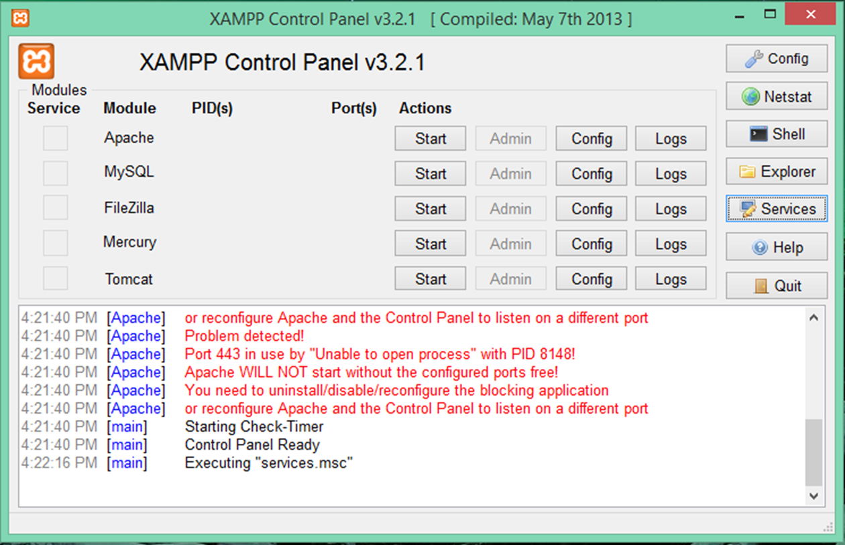
PHP Variables: Arrays
But first,
remember…
XAMP
Notes:
I would like to encourage everyone to open up and start the XAMP control panel.

Slide 9
Start using the tools
Start the xamp control panel
Start the apache web service
Notes:
The best way to learn is by doing.

Slide 10
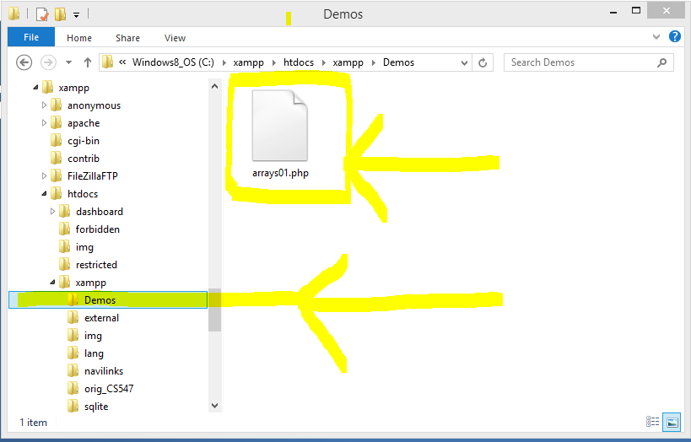
Start using the tools
Navigate to your install directory, mine is at
C:\xampp\htdocs\xampp
Create a new directory to experiment in
Create a new php file
Notes:
Screen shot of what to do.

Slide 11
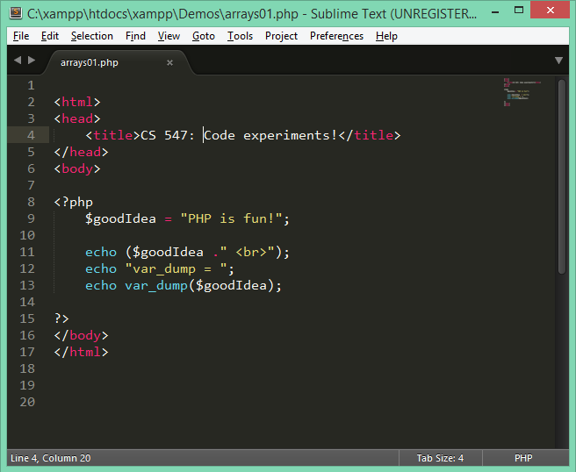
Start using the tools
Open up your favorite editor
Enter some code…
Save the file
Notes:
Screen shot of what to do.

Slide 12
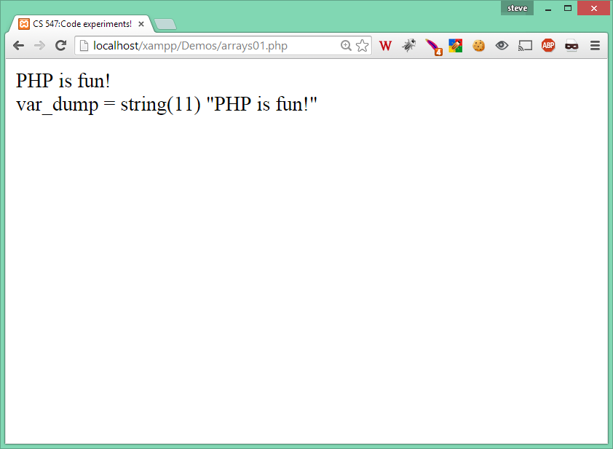
Start using the tools
View in your browser!
Notes:
Screen shot of working development environment.

Slide 13
PHP Arrays:
In PHP there are three types of arrays
Indexed
Associative
Multidimensional

Slide 14
Arrays: Indexed
Indexed arrays are ‘regular’ arrays.
Two ways to create an indexed array
Automatically
Manually

Slide 15
Arrays:
Recall: we can create the following
$fruit1= “Apple”;
$fruit2= "Banana";
$fruit3= “Strawberry";
But this is not efficient.

Slide 16
Arrays: Indexed
We can create our array Automatically
$fruits= array(“Apple", "Banana", “Strawberry");
Notes:
At declaration time

Slide 17
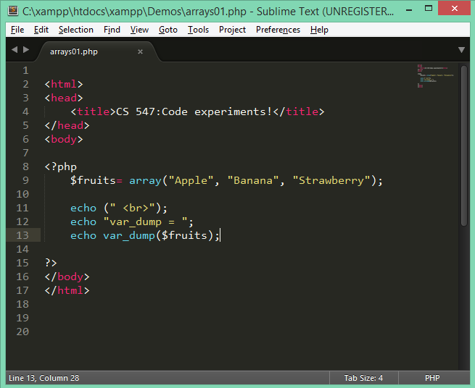
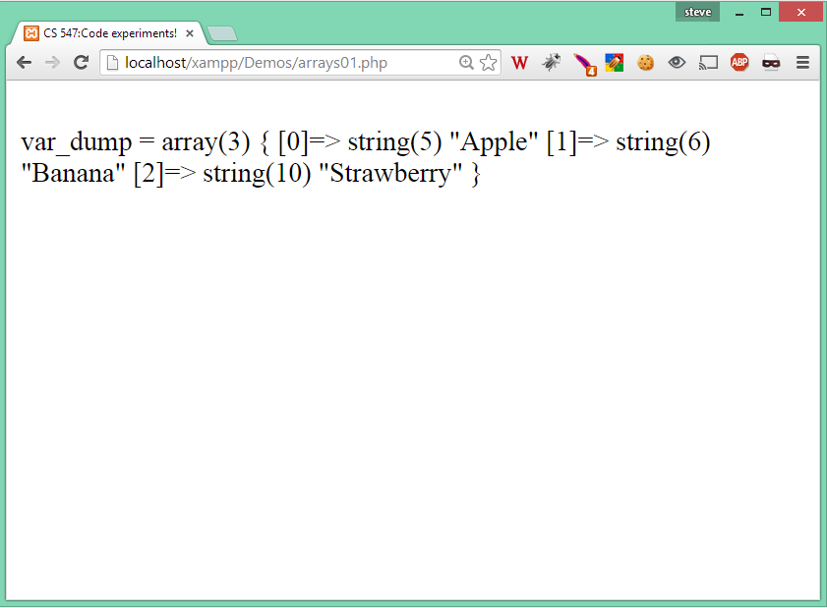
Arrays: Indexed

Slide 18
Arrays: Indexed
We can create our array Manually
$fruits[0] = “Apple";
$fruits[1] = “Banana";
$fruits[2] = “Strawberry";
Notes:
Implicitly created

Slide 19
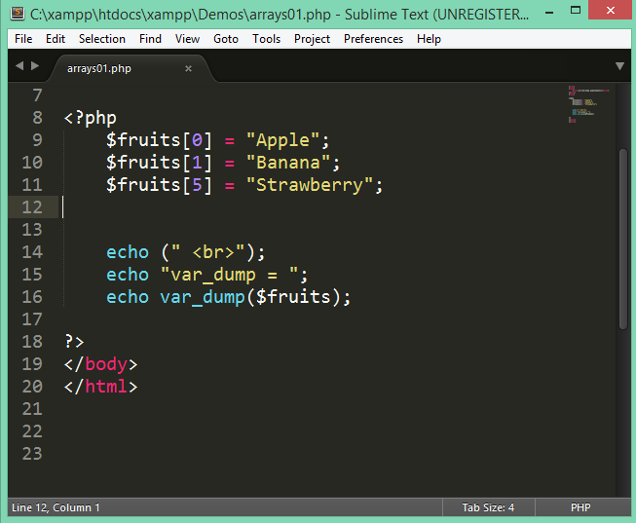
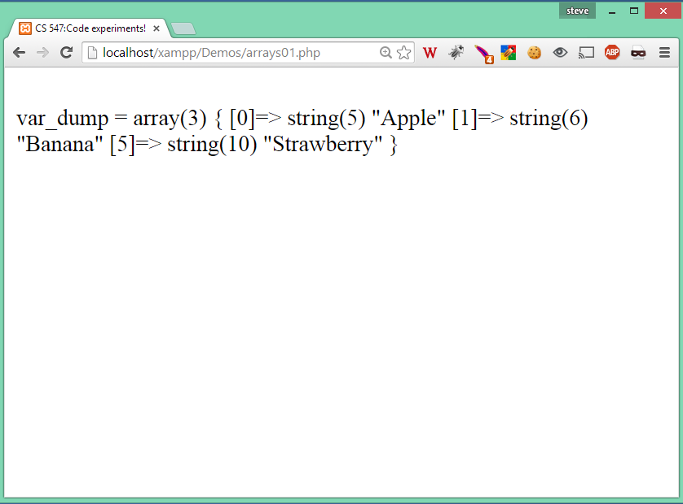
Arrays: Indexed

Slide 20
Arrays: Indexed
Note you can assign the index with any value using….
$fruits= array(0 => "Apple", 1 =>"Banana", 5 =>"Strawberry");

Slide 21
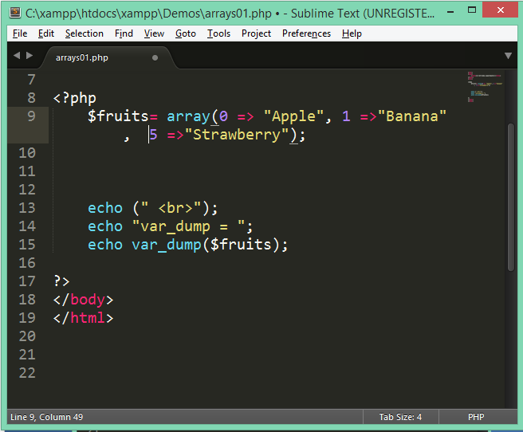
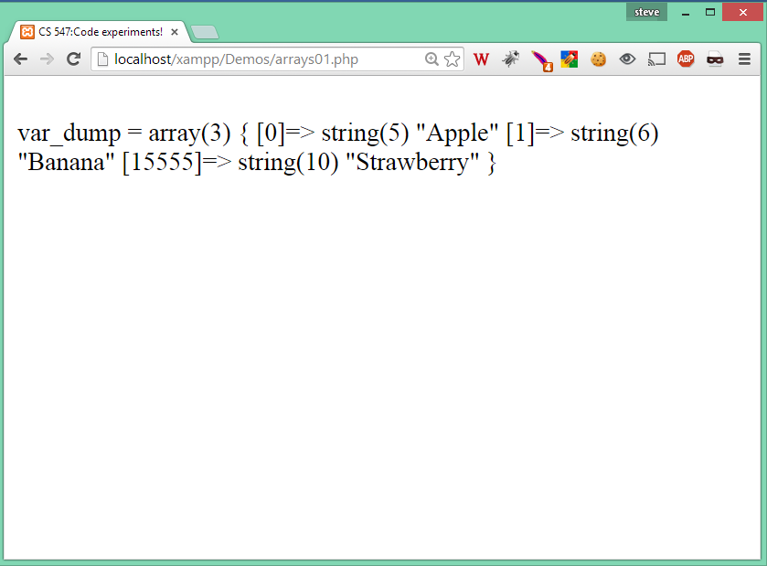
Arrays: Indexed
Notes:
This brings up an interesting point about the index… it can be anything!

Slide 22
Arrays: Indexed
What if we wanted to print the fruit array?
We would need loop over the length of the array and print.
$fruitLength = count($fruits);
for ($i=0; $i < $fruitLength; $i++) {
echo ("Fruit[$i] = $fruits[$i]<br>");
}

Slide 23
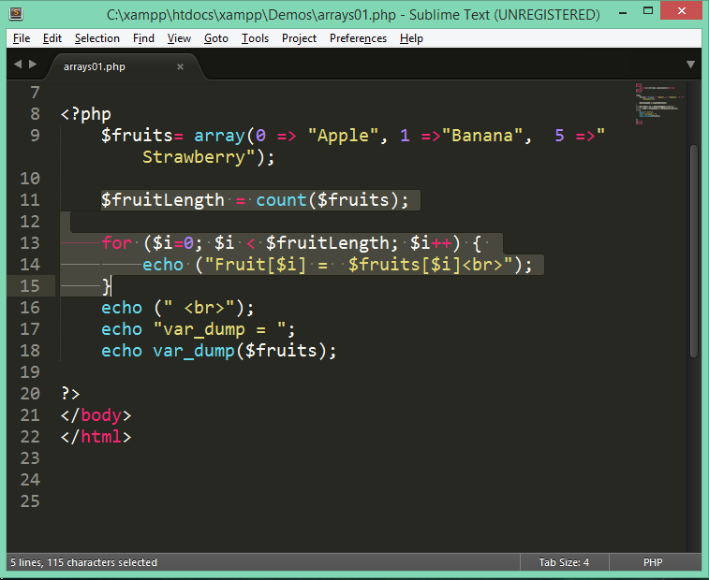
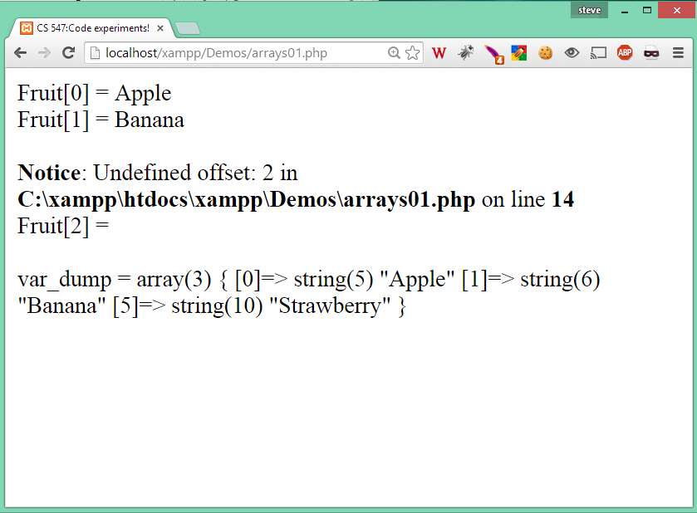
Arrays: Indexed
Notes:
But be carefull! This illustrates the problems of iterating over an array with ‘gaps’ in the index. Not a problem in PHP.

Slide 24
Arrays: Indexed
We can fix this by iterating over the keys and values in the array.
Use the foreach loop like...
foreach ($fruits as $key => $value) {
echo ("Fruit[$key] = $value <br>");
}

Slide 25
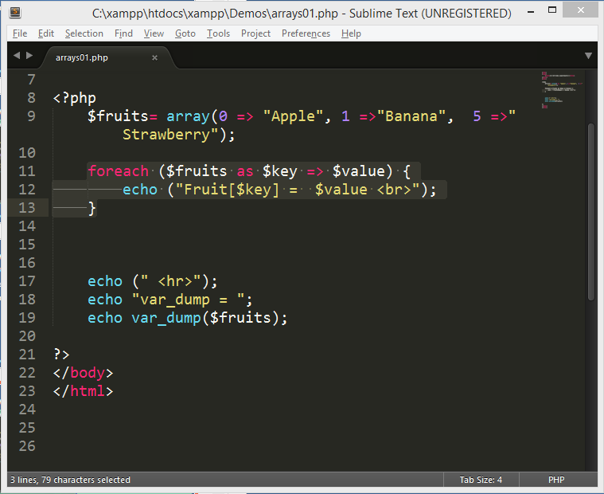
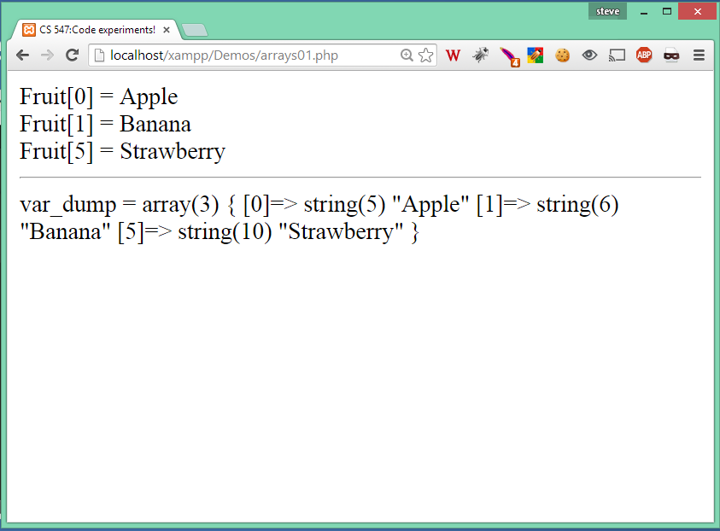
Arrays: Indexed
Notes:
But be carefull! This illustrates the problems of iterating over an array with ‘gaps’ in the index. Not a problem in PHP.

Slide 26
Arrays: Indexed => Associative
This introduces the concept of associative arrays
What if,
instead of using an integer value for the key, we used something else,
like a string?
This is the basis for associative arrays in PHP

Slide 27
Arrays: Associative
Associative arrays are indexed arrays that use a string for the index.
foreach ($fruits as $key => $value) {
echo ("Fruit[$key] = $value <br>");
}

Slide 28
Arrays: Associative
Associative arrays are indexed arrays that use a string for the index.
There are two ways to create them
Manually
$fruits[“Monday”] = “Apple”;
$fruits[“Tuesday”] = “Banana”;
$fruits[“Friday”] = “Strawberry”;
Automatically
$fruits= array( "Monday" => "Apple",
"Tuesday" => "Banana",
"Friday" => "Strawberry");

Slide 29
Associative Arrays
Associative arrays are a very powerful feature of PHP.
They are used in many applications
There is a rich set of functions to work with arrays.
Notes:
Usefull in GUIs, HTML forms, Word Processing. Tag Counts…
We will go over the built in functions shortly.

Slide 30
Arrays: Multidimensional
In PHP arrays can contain any valid variable including other arrays.
So a multi-dimensional array is an array of arrays.

Slide 31
Arrays: Multidimensional
Consider the following:
$fruits= array("Apple", "Banana", "Strawberry");
$meats= array("Antelope", "Beef", "Chicken");

Slide 32
Arrays: Multidimensional
We can create an array of arrays as follows:
$fruits= array("Apple", "Banana", "Strawberry");
$meats= array("Antelope", "Beef", "Chicken");
$groceries = array ("fruits" => $fruits,
"meats" => $meats);

Slide 33
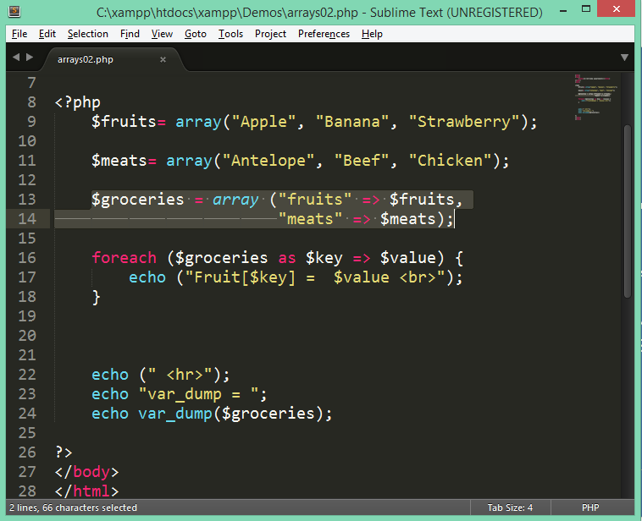
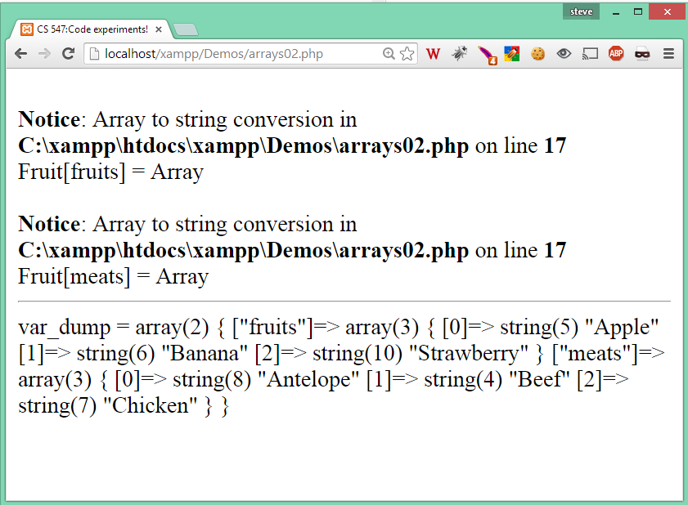
Arrays: Multidimensional
Let’s print our array of arrays.

Slide 34
Arrays: Multidimensional
We need to access the array index properly
There are several ways of doing this…
reference the internal array using
the index as a string
or
the index as a key

Slide 35
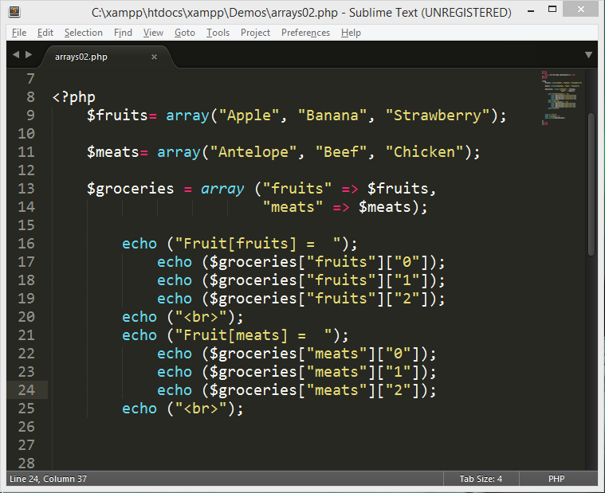
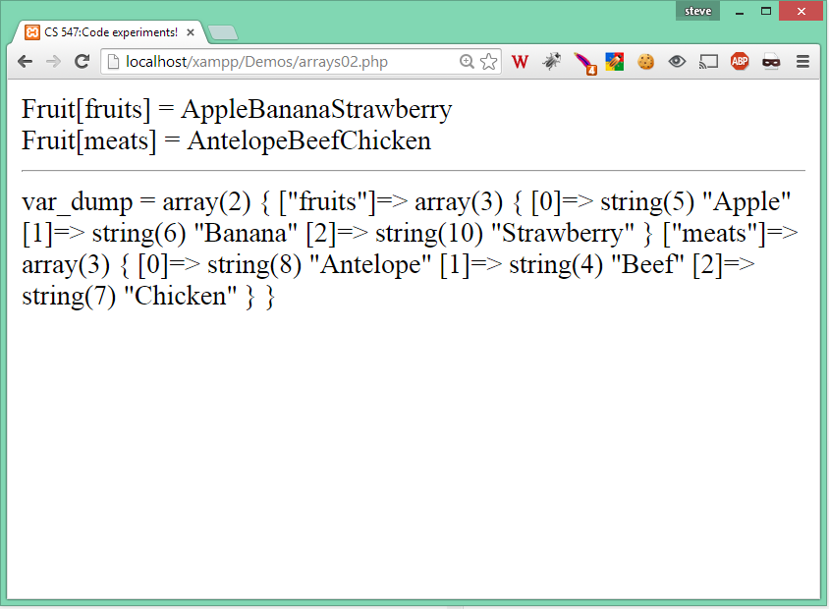
Arrays: Multidimensional
Let’s print our array of arrays.
Notes:
This is not very efficient way of doing it.

Slide 36
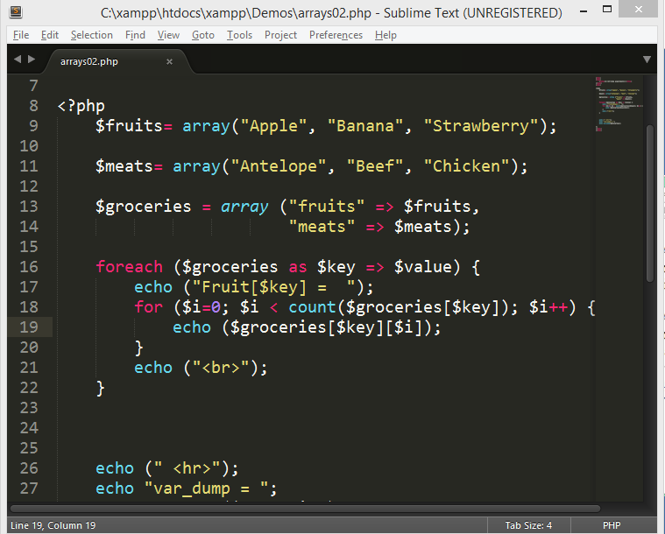
Arrays: Multidimensional
Let’s print our array of arrays.
Notes:
This is a little better, but there is a better way

Slide 37
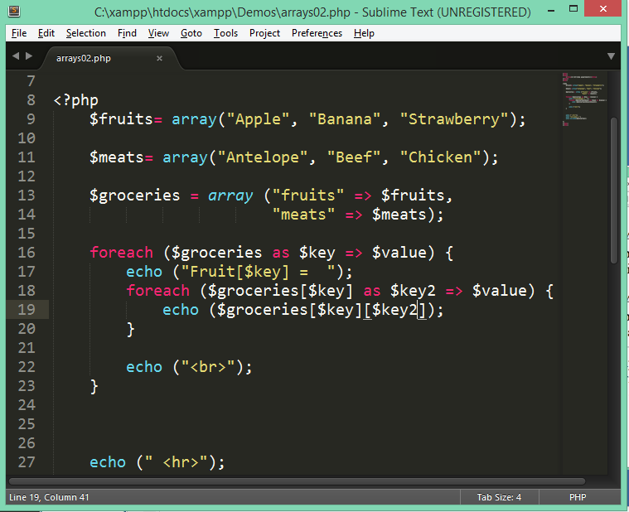
Arrays: Multidimensional
Let’s print our array of arrays.
Notes:
This is preferred. Double foreach loops over keys.

Slide 38
Arrays: Built in Functions
There is a rich body of built in array functions in PHP. The following slides present the full list of array functions taken from the PHP Manual Website.
Homework
Follow this link to the php.net website and familiarize yourself with the array functions.
Notes:
Expected completion time, 1 hour.

Slide 39
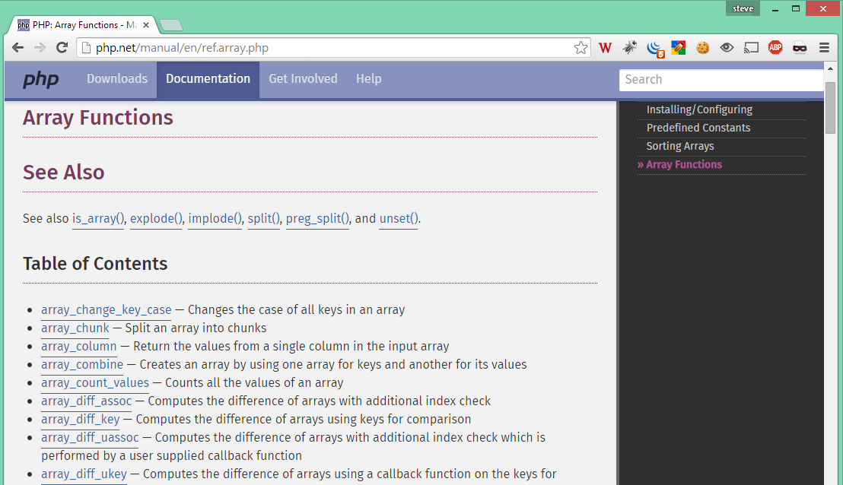
Array Functions Homework
Familiarize yourself with the functions on the php.net manual website.

Slide 40

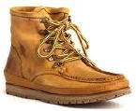
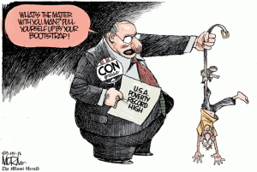
Next topic:
Bootstrap
Notes:
Pulling your self up by your bootstraps….

Slide 41
Bootstrap
What is Bootstrap?
Bootstrap is a free front-end framework for faster and easier web development
Bootstrap includes HTML and CSS based design templates for typography, forms, buttons, tables, navigation, modals, image carousels and many other, as well as optional JavaScript plugins
Bootstrap also gives you the ability to easily create responsive designs
Notes:
Developed by

Slide 42
Bootstrap: History
Bootstrap was developed by Mark Otto and Jacob Thornton at Twitter, and released as an open source product in August 2011 on GitHub.
Was the No.1 project on GitHub back in June 2014

Slide 43
Bootstrap: Justification
I think it is cool and useful
Easy to use: Anybody with just basic knowledge of HTML and CSS can start using Bootstrap
Responsive features: Bootstrap's responsive CSS adjusts to phones, tablets, and desktops
Mobile-first approach: In Bootstrap 3, mobile-first styles are part of the core framework
Browser compatibility: Bootstrap is compatible with all modern browsers (Chrome, Firefox, Internet Explorer, Safari, and Opera)

Slide 44
Bootstrap: Downloading
Download Bootstrap from getbootstrap.com
Include Bootstrap from a CDN (recommened)

Slide 45
Learning to use Bootstrap
We will be using bootstrap to make our websites look and respond better. There is an extensive set of instructions on how to use the various features of the Bootstrap Framework. Rather than reiterating that material, it is expected that you dedicate one to two hours per week learning Bootstrap by example.
The starting place is the getting started section of the bootstrap website. We will cover some basics in class. You can use any of the features you want on your websites.

Slide 46
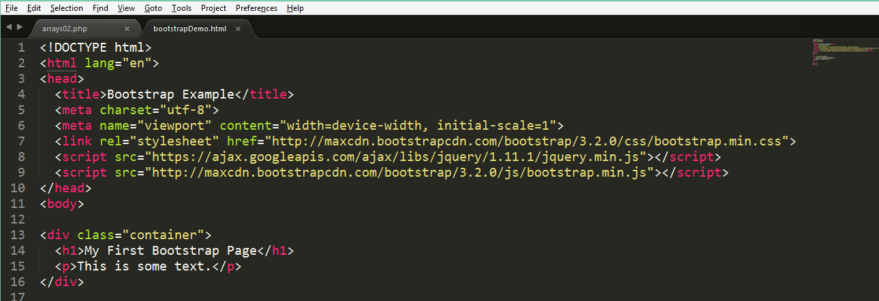
Bootstrap: Simple example
Copy the following code into an html file in your xamp directory.

Slide 47
Bootstrap from GitHub
Code demo.

